Slide 1
Open Access Infrastructures in Finland
1.6.2022
Kristiina Hormia-Poutanen, Service director
National Library of Finland
Picture: Sankai / Canva

Slide 2
Agenda
Open Science policy and coordination
Licensing enabling OA publishing
Finnish Scholarly Journals and Books Online
Institutional Repository service
OA University Presses
Access to OA content

Slide 3
National coordination of Open Science in Finland
National coordination of Open Science in Finland is led by the Federation of Finnish Learned Societies since 2018
Roles
Research organisations are responsible for OS activities within their organisations
Research funding organisations require OA
Declaration for Open Science and Research 2020-2025
Policies and recommendations
See more: https://avointiede.fi/en
Picture: Unsplash

Slide 4
Licensing enabling OA publishing
FinELib is a consortium of Finnish universities, research institutions and public libraries. FinELib promotes availability of e-resources and open access publishing.
Most of the FinELib’s agreements with major scholarly publishers have since 2017 allowed authors to publish their research OA at no additional cost to them or with discounted APC
The consortium service unit operates at the National Library of Finland NLF.

Slide 5
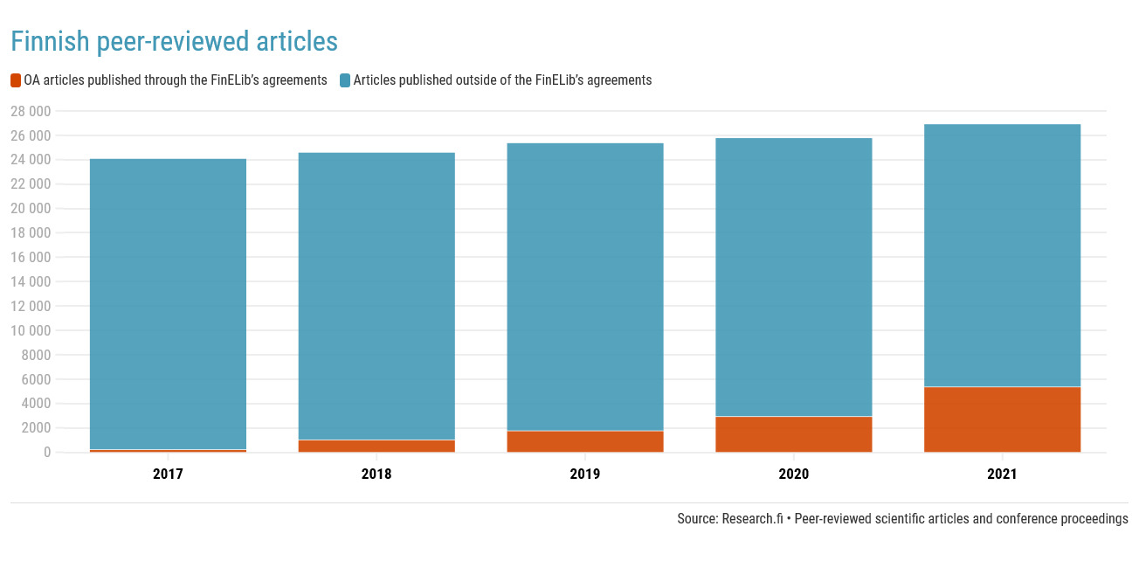

Slide 6
Journal.fi
A platform for Finnish online journals maintained by the Federation of Finnish Learned Societies since 2017
120 Finnish scholarly journals
Mostly small journals published by member societies
Based on Open Journal Systems 3 (https://pkp.sfu.ca/)
a platform for publishing journal articles
a tool for editorial work - around 30-40% of journals use the editorial workflow
See more: https://journal.fi

Slide 7
Journal.fi - policies and support
Allows 12 month embargoes, most journals are open access
Support includes:
A shared platform and system upgrades
Coding services (has to benefit all publishers)
Online technical support (mostly OJS questions)
Workshops
Written guides

Slide 8
Edition.fi
Journal.fi for books, based on Open Monograph Press
A very open policy: no immediate OA demand for publishers, but all books added have to be free to read
No technical support for paywalls
No option for adding just the metadata of books
Publishers can sell their books if also available in OA
Policy will be re-evaluated when Plan S for books is ready
Support includes similar things than journal.fi
It´s hoped to attract also bigger publishers to release older monographs and edited volumes

Slide 9
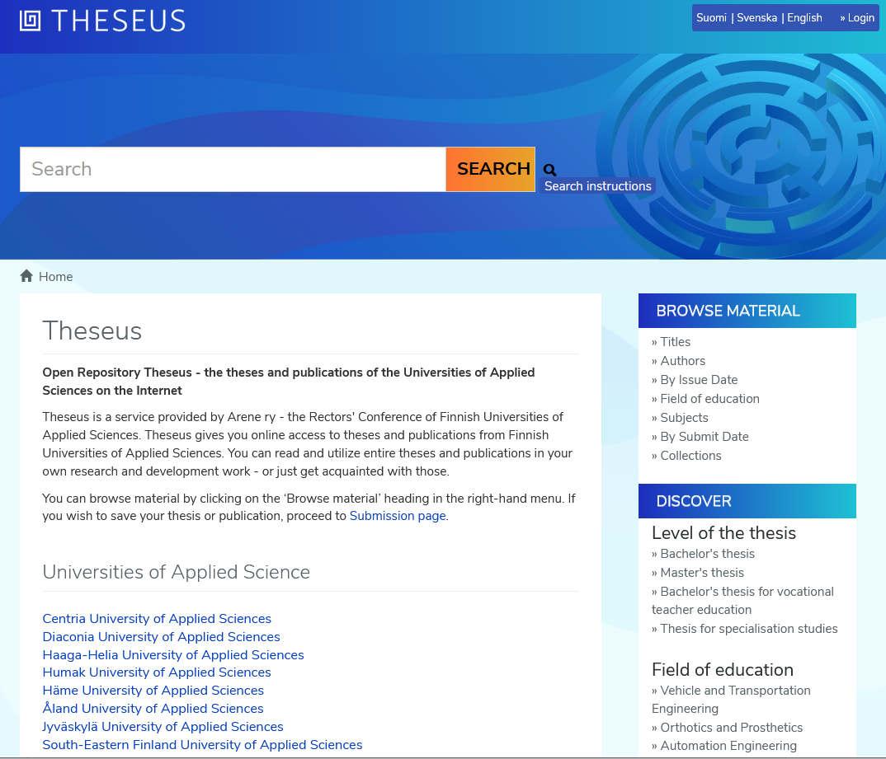
Repository services at the National Library of Finland
The National Library provides hosted repository services for 48 Finnish organisations
Each client pays a fixed annual service fee which covers the costs
Clients include universities, universities of applied sciences, state research institutes, other governmental organisations
Division of responsibilities
The National Library is responsible for the technical platform
Each client organisation administers its own collections

Slide 10
Technical platform
All repositories are run in a standardised technical infrastructure
The services are based on the open source DSpace platform
Benefits from the standard DSpace tools and interfaces
Some local customisations done as well
The National Library is a long-time member of the global DSpace community
Involved with community governance; provides financial support

Slide 11
Contents and usage
More than 0,5 million openly available full-text items
Theses and dissertations, serial publications, self-archived scholarly articles, cultural heritage materials
The publications are easy to find
Metadata is harvested by the national Finna.fi discovery service
Highly visible in general Internet search engines as well
Many of the publications reach a wide audience
38 million full-text downloads in 2021

Slide 12
OA University Presses
Helsinki University Press
Fully open access University Press
Peer reviewed books and journals
All academic fields
Tampere University Press
Peer reviewed scholarly books
Social sciences, humanities, educational sciences
The Publishing House of The Finnish Literature Society
the largest publisher of arts related non-fiction in Finland
60 new titles/ year in the fields of folklore, ethnology, history, art, literary criticism and Finnish language research.

Slide 13
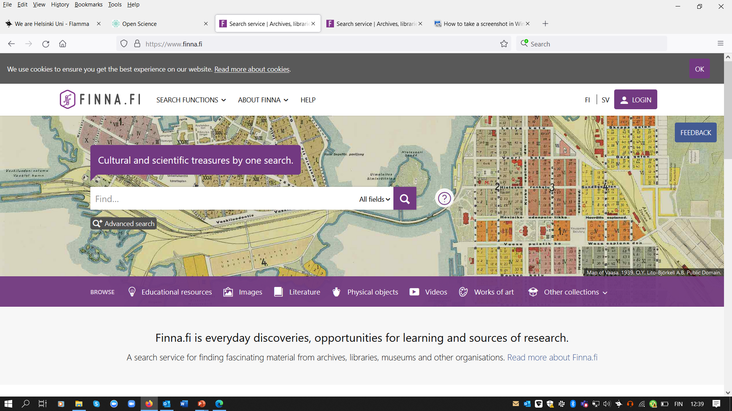

Slide 14
A shortcut to research-based knowledge
The Finna.fi search service gives you access to a wealth of Finnish open access research knowledge in a single search.
A landing page introducing research-based material that is available directly online.
Ready made shortcuts and search tips.

Slide 15
Finna Classroom
Finna is a safe place for learning. Visit the Finna Classroom where museums and archives, with teachers, have built ready-to-use teaching content.
In open-access educational resources, you can find exercises and new ideas for all educational levels.
This content is only in Finnish and Swedish

Slide 16
Open Educational resources
A search tab for finding materials stored in the Library of Open Educational Resources.
Useful for independent competence development, studies and teaching.
Use the learning filters to filter your search results.

Slide 17
www.nationallibrary.fi
Kristiina Hormia-Poutanen
kristiina.hormia@helsinki.fi

